Slide 1
Data Modeling with Maheen Naqvi
DATA MODELING DATA MODELING DATA MODELING
MODELING DATA MODELING DATA MODELING DATA

Slide 2
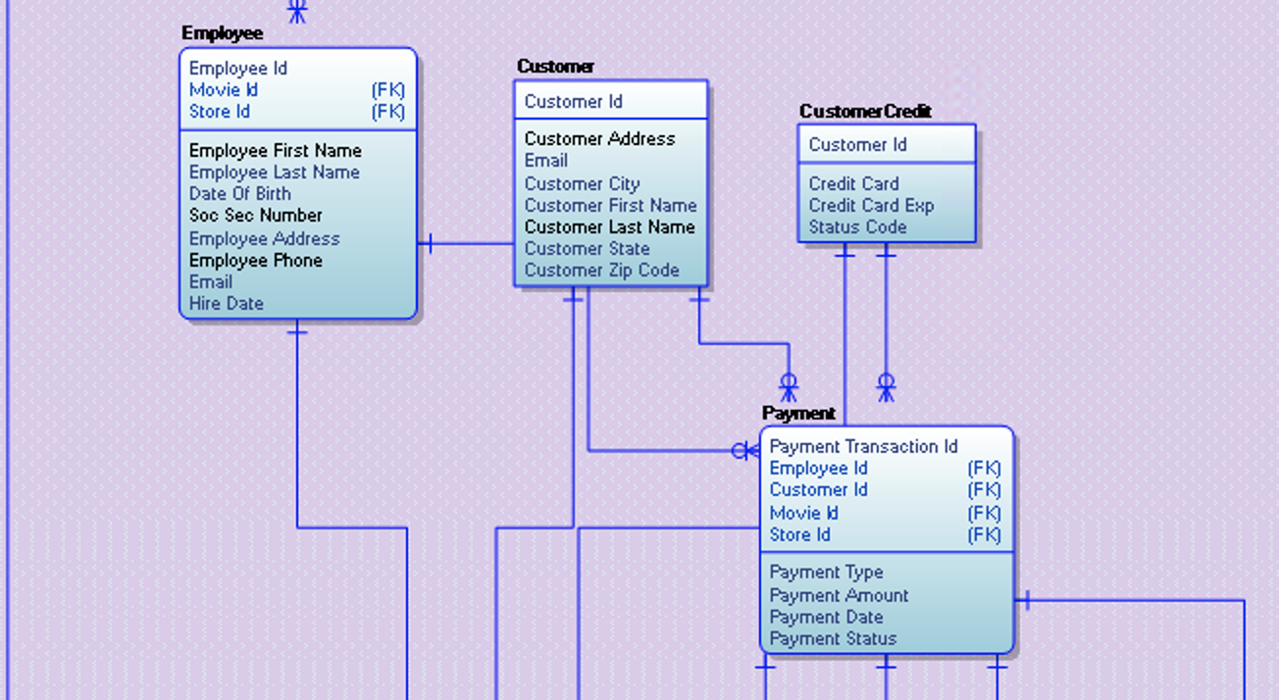
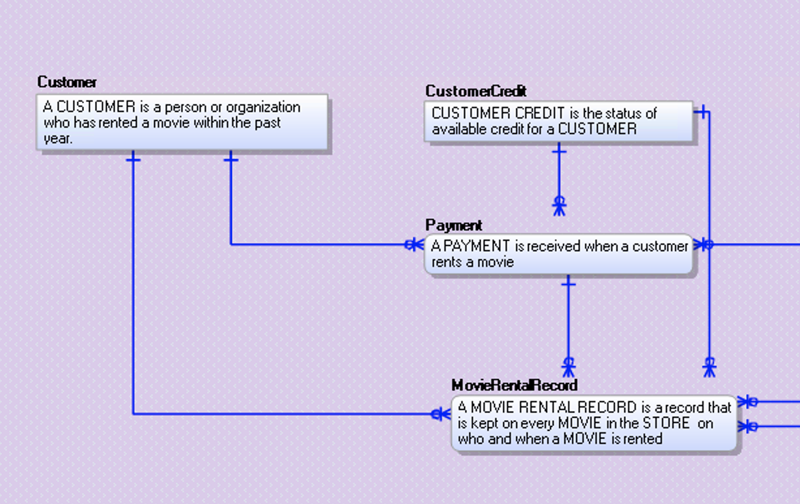
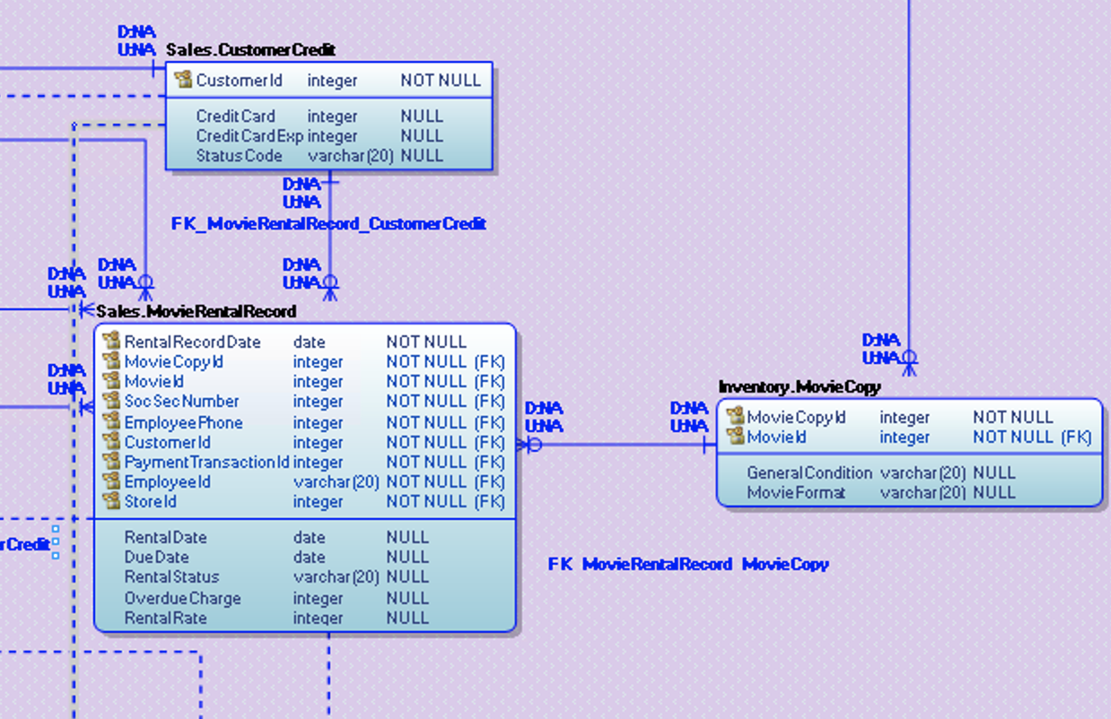
3 Musketeers – Quick View
Physical Data Model
Logical Data Model
Conceptual Data Model

Slide 3
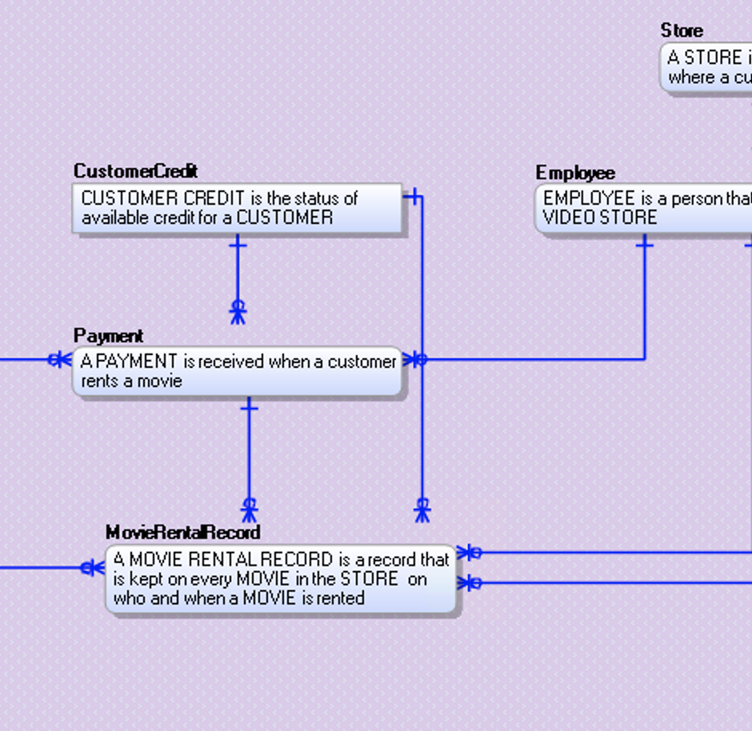
My eMovies CDM

Slide 4
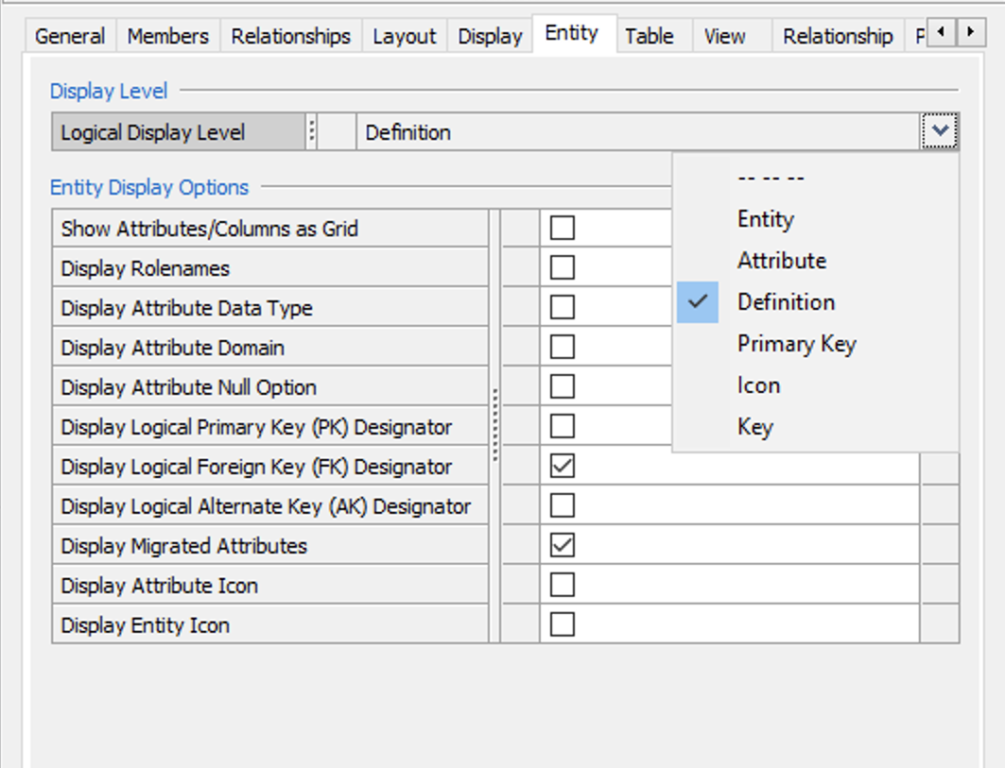
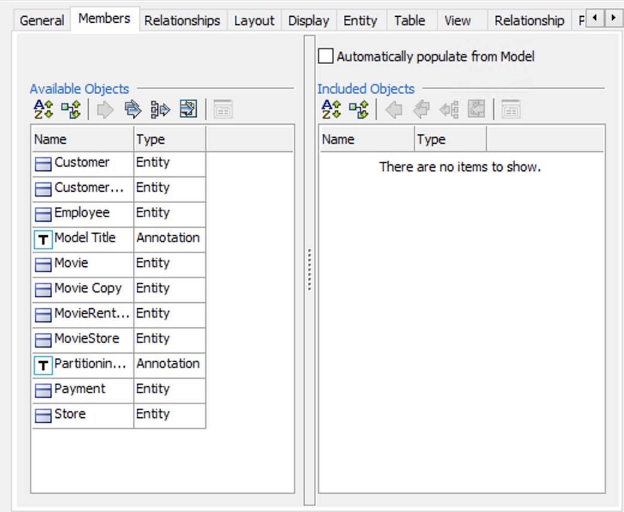
Conceptual Data Model
CDM CDM CDM CDM CDM CDM CDM CDM
How to make modernized CDM:
Click ER diagrams in Model Explorer
Right click and choose NEW
Name it as CDM
Right click on the Window Panel and choose Properties
Under the tab entity, you will see a Display Level, you can choose definitions from the dropdown menu
Click on the Members tab and populate the model by clicking this arrow
Use hierarchical layout from the Diagram Menu and your CDM is ready!

Slide 5
Conceptual Data Model
01
Shows the critical business objects
02
Interaction of the business objects with each other
Shows the critical Business Definitions
Provide high-level solutions
03
04
Why should we make CDM?
CDM CDM CDM CDM CDM CDM CDM CDM

Slide 6
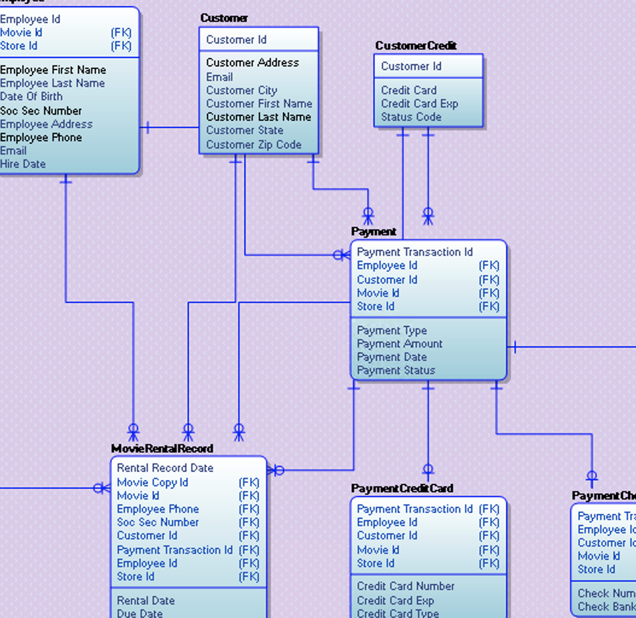
My eMovies LDM

Slide 7
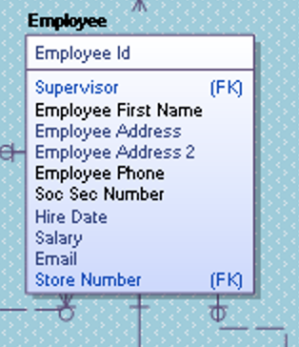
Logical Data Model
LDM LDM LDM LDM LDM LDM LDM LDM
How did I make modernized LDM:
Change “number” to identifier

Slide 8
Logical Data Model
LDM LDM LDM LDM LDM LDM LDM LDM
How did I make modernized LDM:
Change “number” to identifier
Delete irrelevant columns and add required information

Slide 9
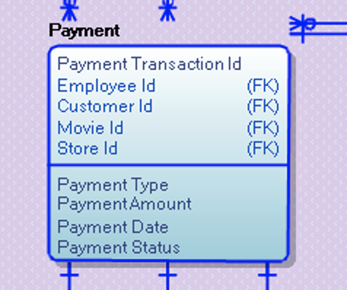
Logical Data Model
LDM LDM LDM LDM LDM LDM LDM LDM
How did I make modernized LDM:
Change “number” to identifier
Delete irrelevant columns and add required information
Rearranging the columns

Slide 10
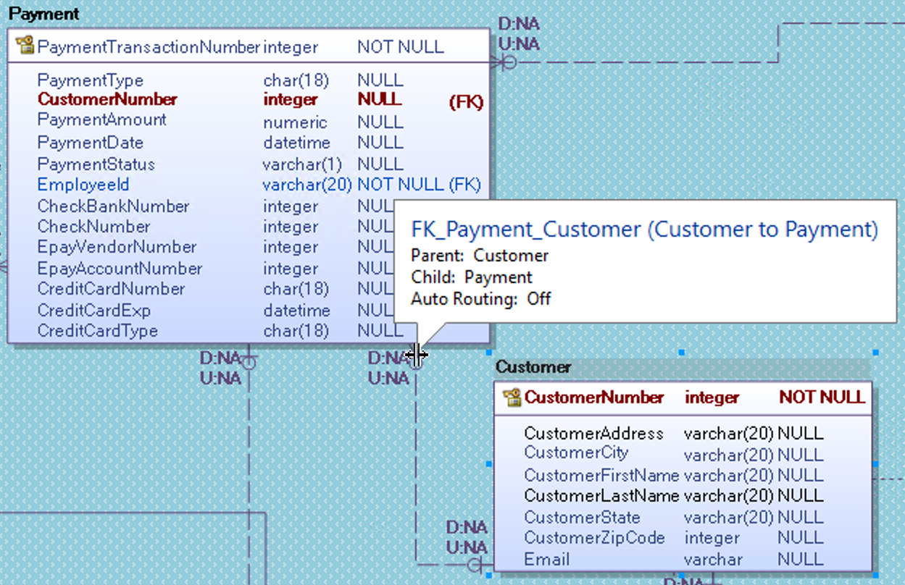
Logical Data Model
LDM LDM LDM LDM LDM LDM LDM LDM
How did I make modernized LDM:
(Normalization)
Remove the duplicate attributes

Slide 11
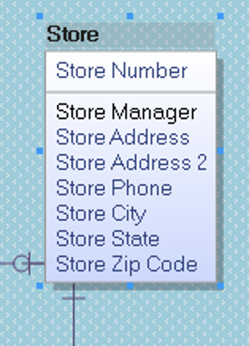
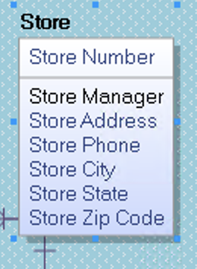
Logical Data Model
LDM LDM LDM LDM LDM LDM LDM LDM
How did I make modernized LDM: (Normalization)
Remove the duplicate attributes
Fix multivalued attributes

Slide 12
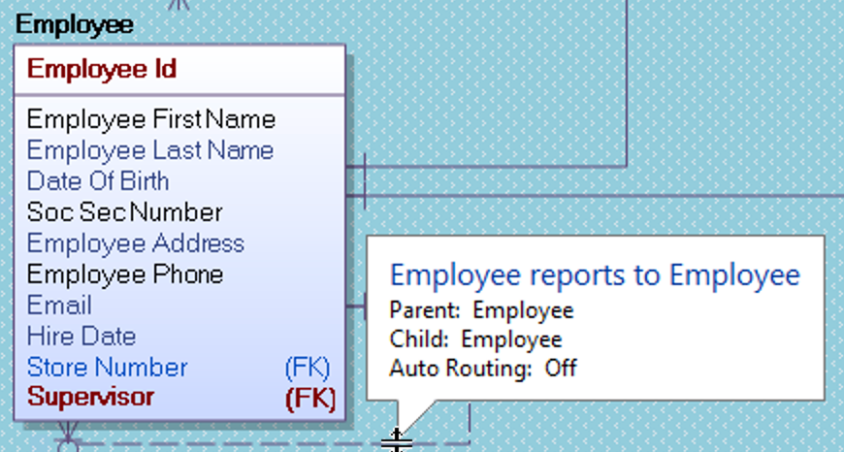
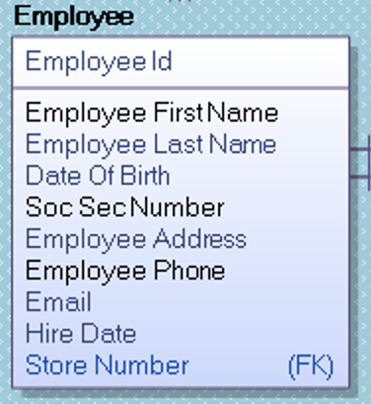
Logical Data Model
LDM LDM LDM LDM LDM LDM LDM LDM
How did I make modernized LDM: (Normalization)
Remove the duplicate attributes
Fix multivalued attributes
Resolve the hidden dependency

Slide 13
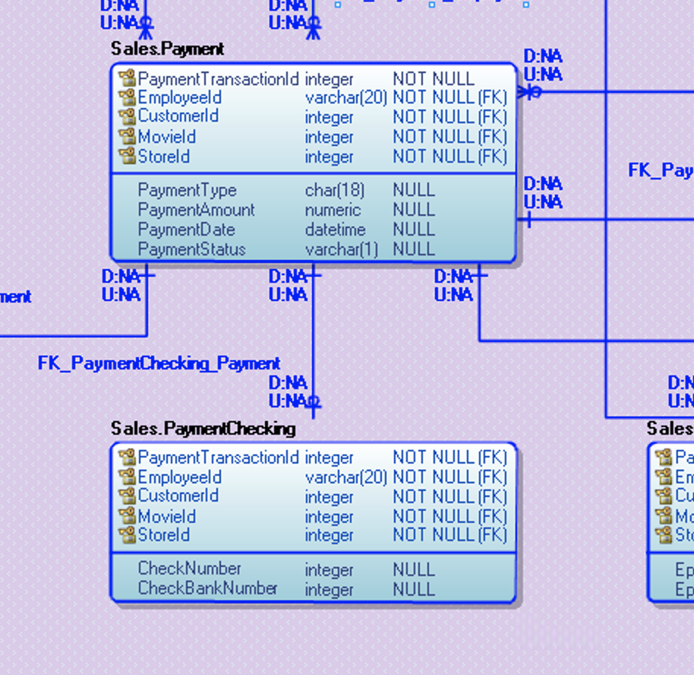
My eMovies PDM

Slide 14
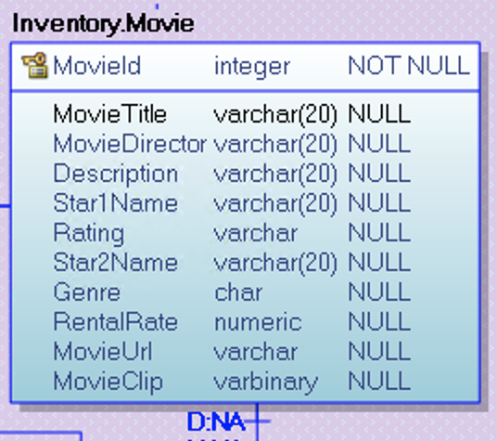
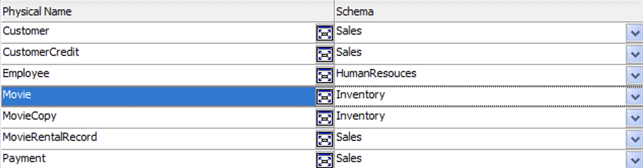
Physical Data Model
PDM PDM PDM PDM PDM PDM PDM PDM
How did I make modernized PDM:
Use fully qualified object names

Slide 15
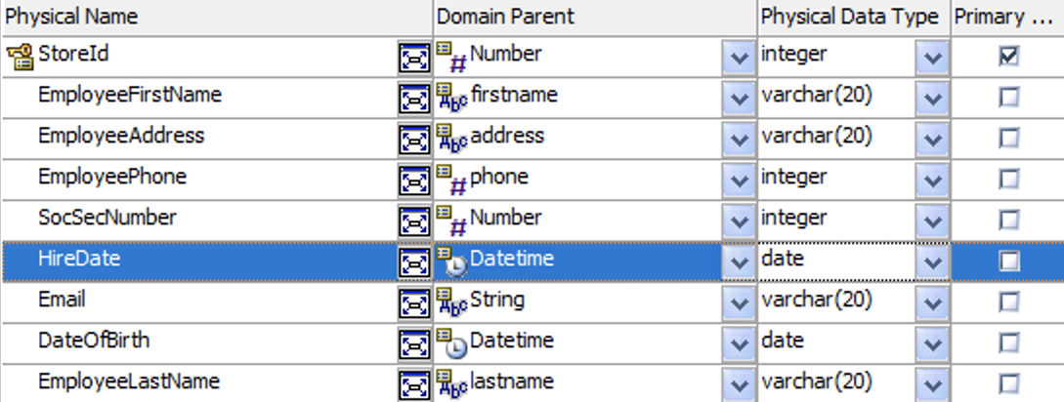
Physical Data Model
PDM PDM PDM PDM PDM PDM PDM PDM
How did I make modernized PDM:
Use fully qualified object names
Fix the datatypes

Slide 16
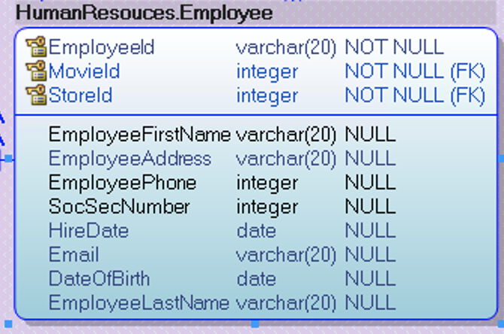
Physical Data Model
PDM PDM PDM PDM PDM PDM PDM PDM
How did I make modernized PDM:
Use fully qualified object names
Fix the datatypes
Use PASCAL case

Slide 17
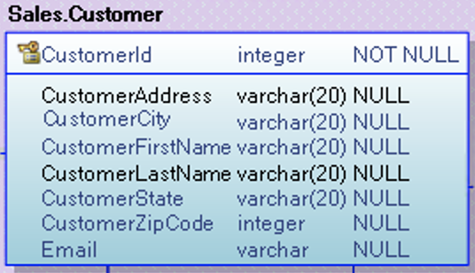
Physical Data Model
PDM PDM PDM PDM PDM PDM PDM PDM
How did I make modernized PDM:
Use fully qualified object names
Fix the datatypes
Use PASCAL case
Remove abbreviations

Slide 18
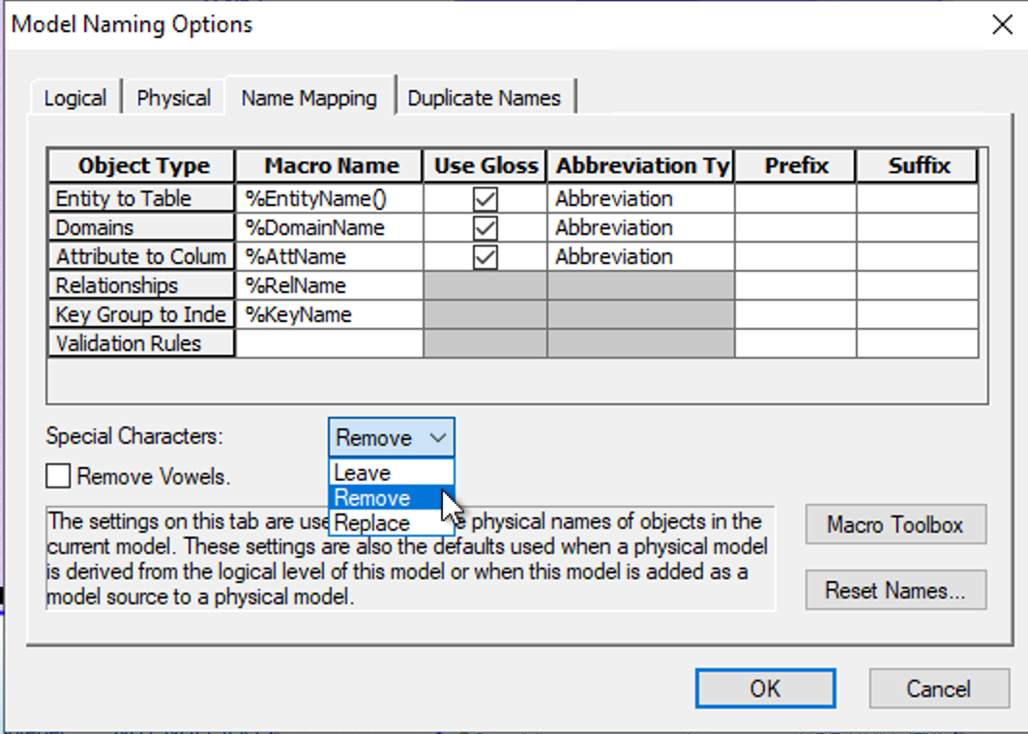
Physical Data Model
PDM PDM PDM PDM PDM PDM PDM PDM
How did I make modernized PDM:
Use fully qualified object names
Fix the datatypes
Use PASCAL case
Remove abbreviations
Remove underscore and spaces

Slide 19
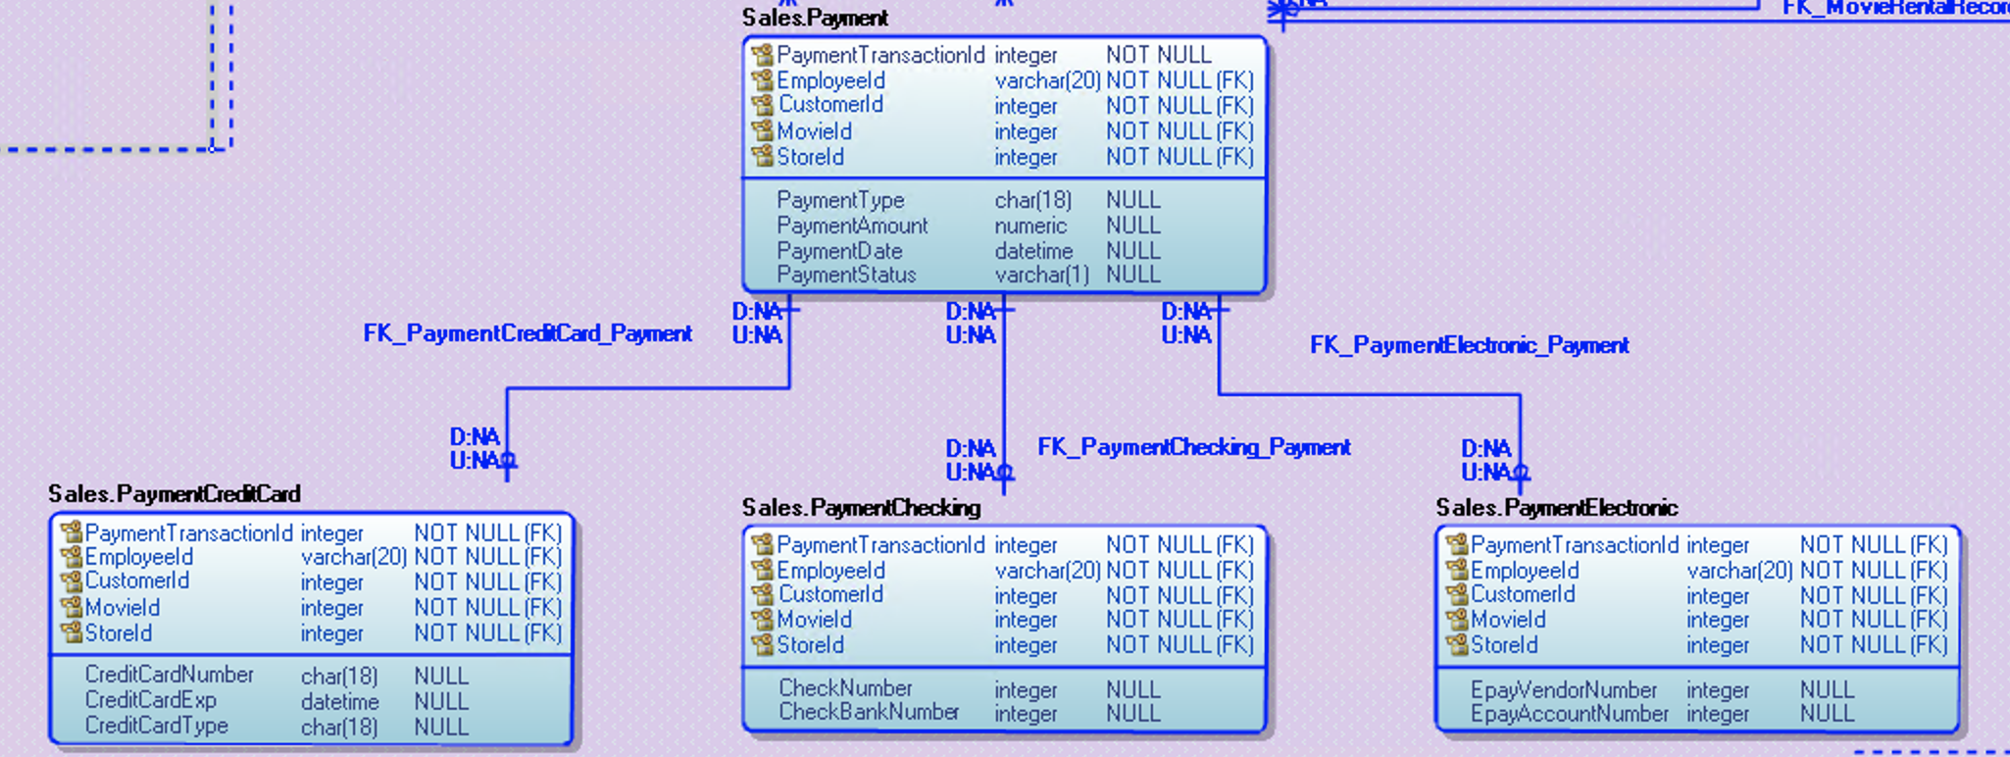
Physical Data Model
PDM PDM PDM PDM PDM PDM PDM PDM
How did I make modernized PDM
(Star Schema):
Fact table: Sales.PaymentTranscation.
Key value PaymentTransactionId
New tables made
Sales.PaymentCreditCard
Sales.PaymentChecking
Sales.PaymentElectronic

Slide 20
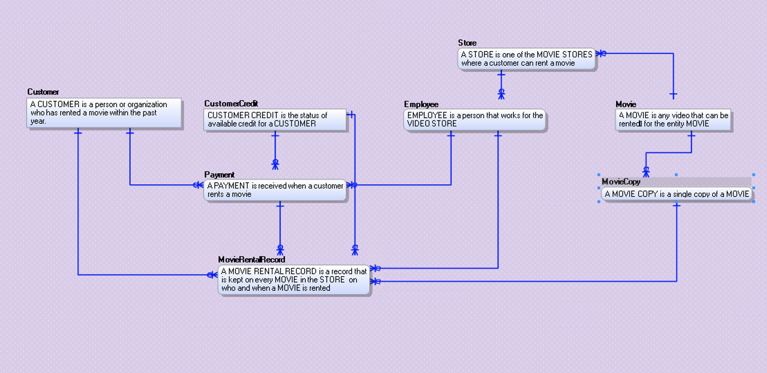
Here’s a full image of how CDM looks like

Slide 21
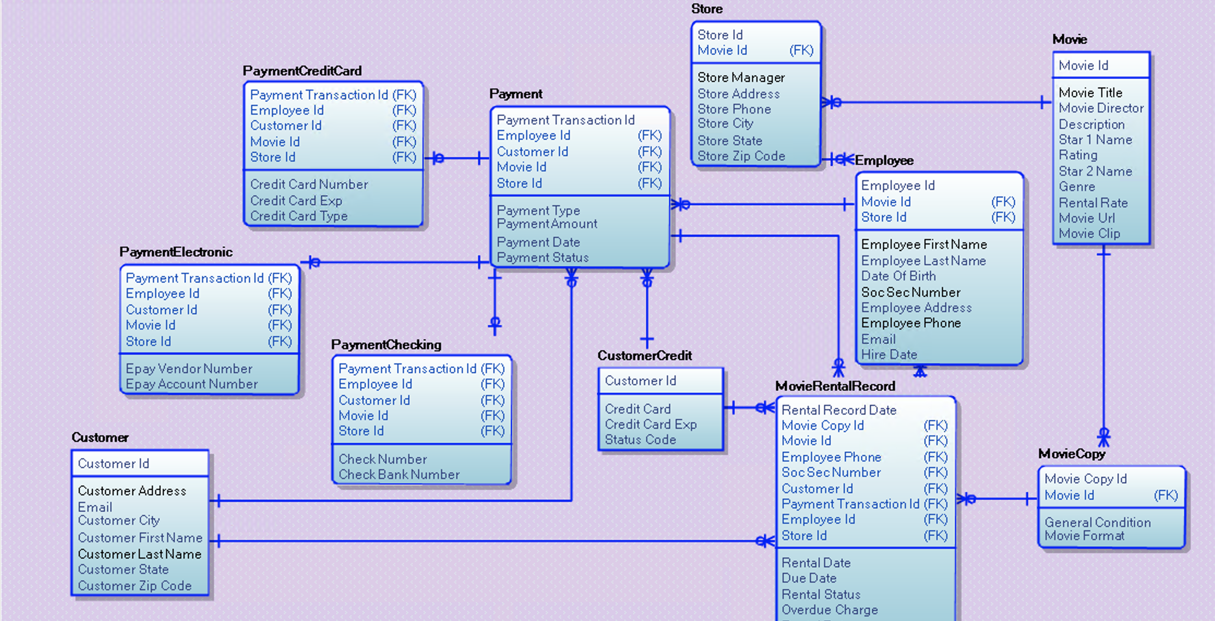
Here’s a full image of how LDM looks like

Slide 22
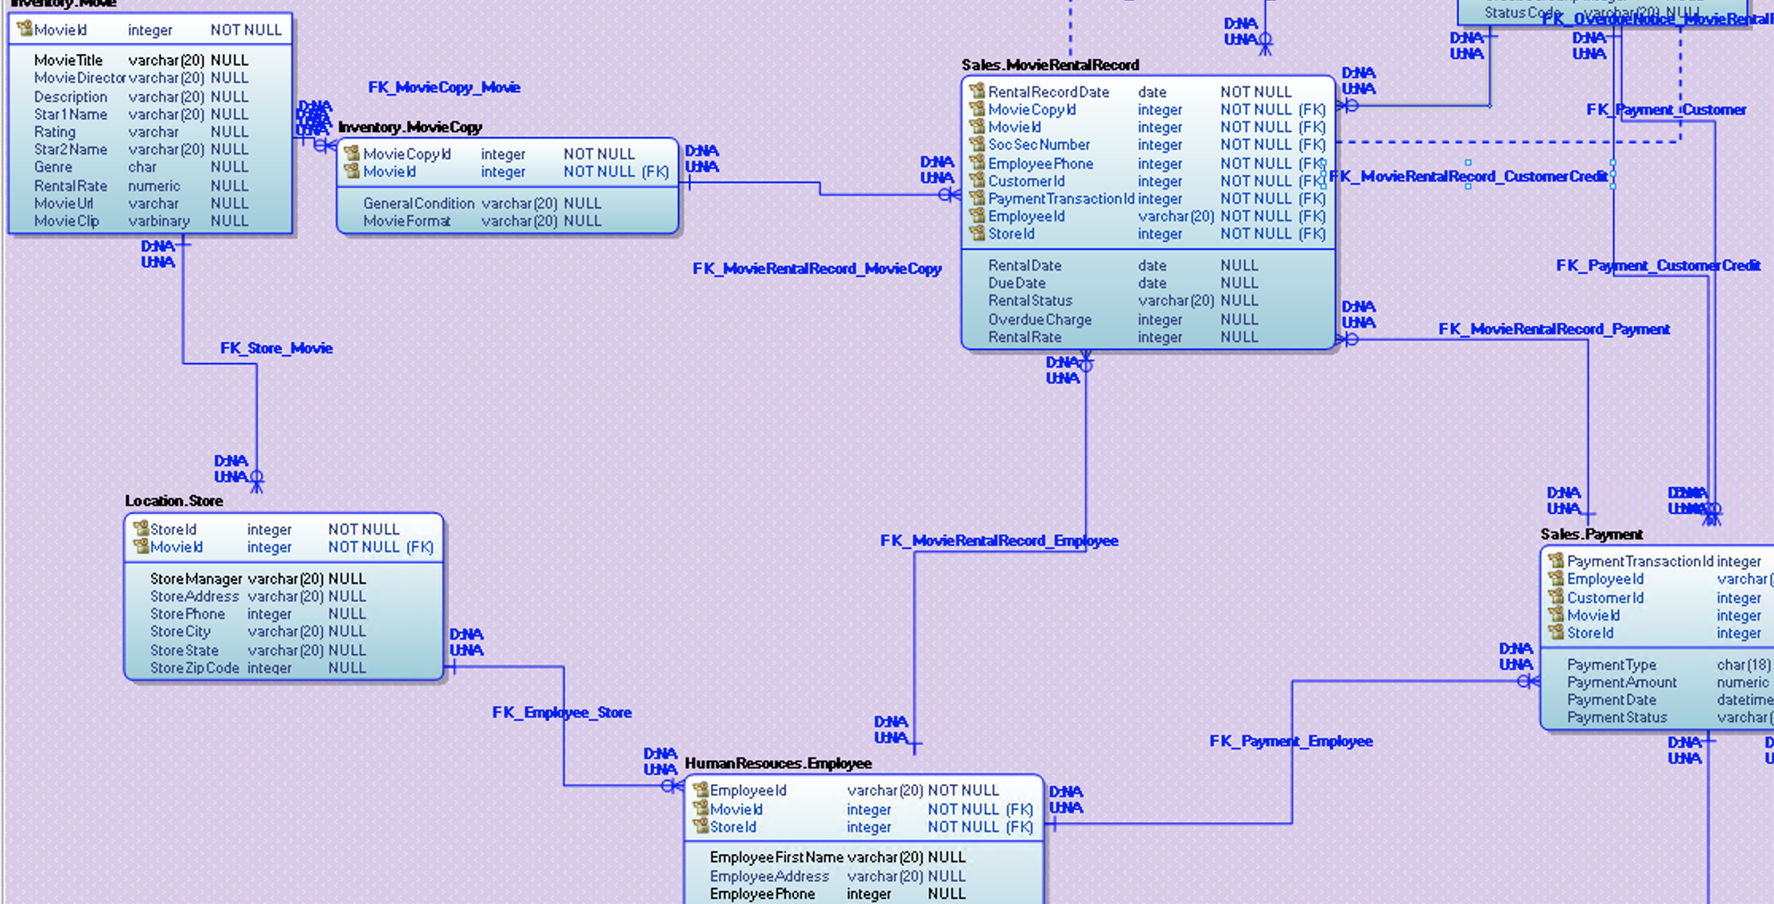
Here’s a full image of how PDM looks like

Slide 23
Thanks
DATA MODELING DATA MODELING DATA MODELING
Do you have any questions?
maheen.naqvi05@qmail.cuny.edu

